Slide 1
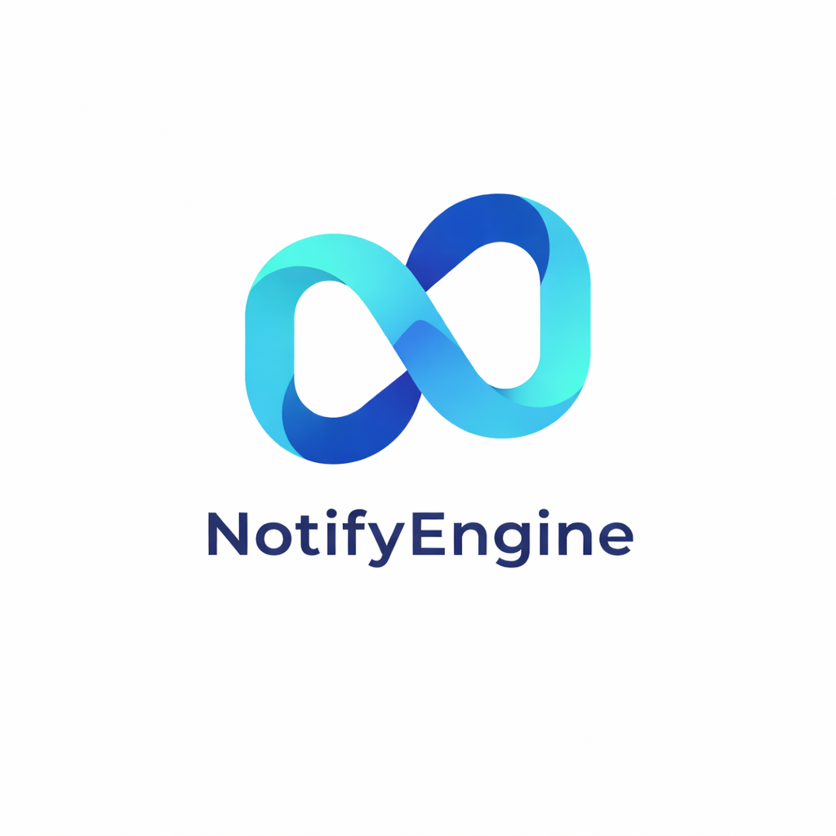
notifyengine.io

Slide 2
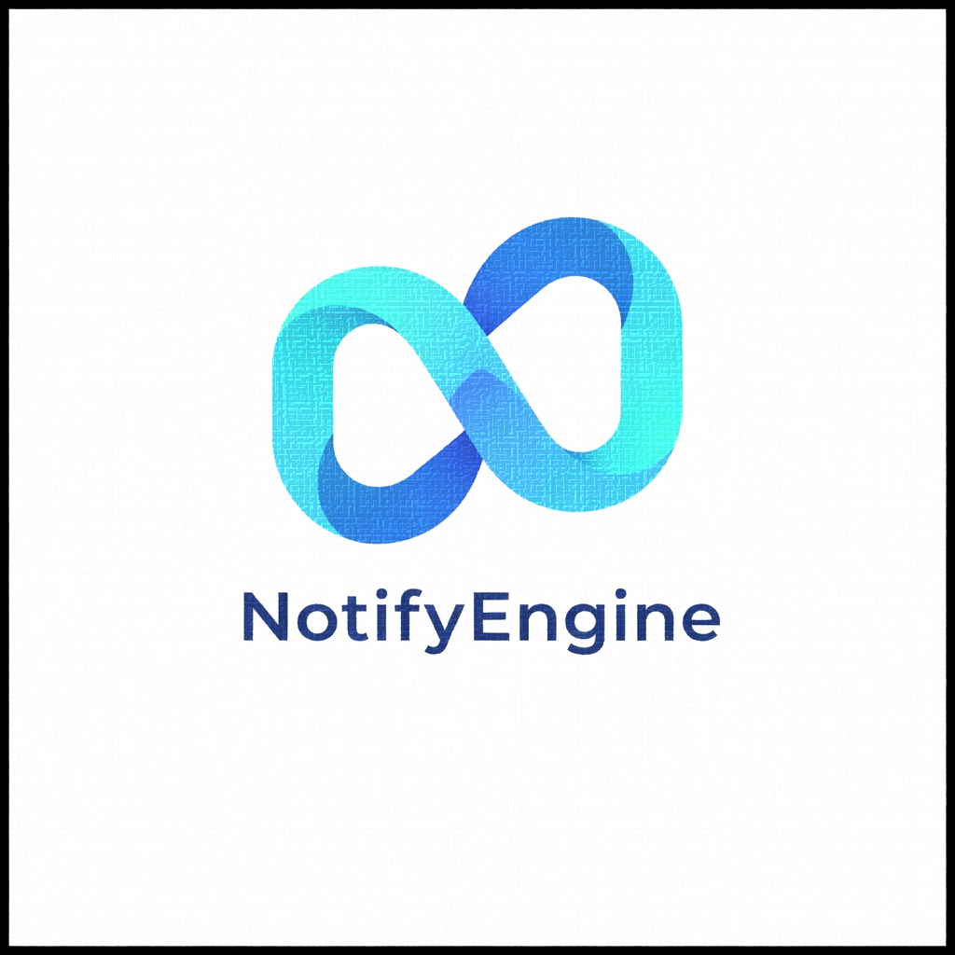
AGENDA
Team Roles
Problem Statement
Project Description
Project Schedule
Personas
Technologies
Algorithms
MVP Definition
Team Working Agreement
Retrospective
AI Disclosure
NotifyEngine

Slide 3



TEAM ROLES
Mohammed N.
Yusif
Krish
Dhorajiya
Rhythm
Patel
Security Engineer /
Project Manager
AI Engineer /
Tester
Security Engineer/
Project Manager
AI Engineer /
Tester
AI Engineer /
Developer
NotifyEngine

Slide 4



TEAM ROLES
Salvatore
Ardisi
Dhawalshree
Mengane
Zeeya
Ramani
SCRUM Master /
Developer
Data Analyst /
Developer
Data Analyst /
Developer
NotifyEngine

Slide 5
WHAT PROBLEM ARE WE SOLVING?
Every app guesses which channel to use: (email, SMS, push, or in-app) and guesses wrong constantly
Static “email-first” rules never adapt, even when user behavior completely changes
No visibility: when a user says “I never got that notification” support teams have zero way to investigate
Developers waste hours writing and maintaining manual routing logic that breaks when behavior shifts
NotifyEngine replaces guesswork with an ML model that learns each user's real behavior, automatically routing every notification to the channel they'll actually engage with
One API call. No routing rules to write. No providers to wire up separately. The system handles everything and gets smarter with every notification it sends
NotifyEngine

Slide 6
PROJECT DESCRIPTION
What
An ML-powered notification delivery service that learns from user behavior and automatically routes notifications to each user's most engaging channel (sms, email, push and in app channels).
Who
For developers and product teams who send high-volume user notifications across different channels.
Why
Unlike static notification tools like Courier, Knock, or Novu that use fixed rules, and enterprise platforms like Braze or MoEngage that are expensive, NotifyEngine offers a simple developer-first API, per-user channel routing that continuously improves with every notification sent.
Benefits
Higher notification engagement rates, lower SMS spend, automatic failover during provider outages, and zero manual routing logic to maintain.
NotifyEngine

Slide 7
PROJECT SCHEDULE
Detailed sprint timeline and milestone tracking
Sprint 0
Sprint 1
Sprint 2
Sprint 3
Weeks 1-3
Weeks 4-6
Weeks 7-9
Weeks 10-12
Planning, Architecture, Team Setup
Static Foundation & E2E Delivery
ML Integration & Adaptive Routing
Circuit Breaker & Dashboard
NotifyEngine

Slide 8
PERSONAS
Sarah Kim
Backend Developer
Daniel Ross
Product Manager
Amanda Lopez
Growth Lead
Series A SaaS (75K users)
Fintech app (500K users)
E-commerce platform (2M users)
Sarah is responsible for integrating email, SMS, and push providers. She currently manages SendGrid, Twilio, and Firebase separately. When a provider fails, she must manually reroute notifications.
Daniel notices engagement rates declining over time. Email open rates have dropped significantly, but routing logic hasn't been updated in over a year.
Amanda spends heavily on SMS notifications because that has always been the default channel. She suspects cheaper channels could perform similarly.
Pain Points
Pain Points
Pain Points
• Multiple provider integrations
• No automatic fallback during outages
• Manual rerouting during incidents
• Complex maintenance overhead
• Declining engagement rates
• Static routing rules
• No behavioral insights
• No visibility into channel performance
• High SMS delivery cost
• No cost optimization strategy
• Engineering dependency for testing
• No performance breakdown by channel
Maps to NotifyEngine
Maps to NotifyEngine
Maps to NotifyEngine
• Unified API
• Circuit breaker pattern
• Automatic channel fallback
• Reduced engineering overhead
• XGBoost adaptive routing
• Real-time engagement dashboard
• Model explainability
• Automatic learning from outcomes
• Cost-aware routing
• Channel performance analytics
• Usage-based pricing alignment
• Zero manual configuration

Slide 9
TECHNOLOGIES
Languages & Frameworks
ML & Data Science
FastAPI · TypeScript · Express · Python · React · Node.js · Vite
XGBoost · Scikit-Learn · Pandas
Databases & Infrastructure
User Interface
PostgreSQL · Redis · Socket.io · BullMQ
Tailwind CSS · shadcn/ui
Tools
Testing
GitHub · Jira · Slack · VS Code · Claude AI
Jest · Pytest
DevOps & CI/CD
Validation
Docker · GitHub Actions
Zod · Pydantic
NotifyEngine

Slide 10
ALGORITHMS
XGBoost Gradient Boosted Decision Tree
Supervised ML model trained on notification delivery outcomes (delivered, opened, clicked, dismissed, ignored)
Input features: channel type, time of day, day of week, hours since last notification, notification count, user engagement history, channel-specific open rates
Output: probability of engagement per channel (highest probability wins)
Epsilon-Greedy Exploration
90% of the time (exploit): route to the channel the model predicts will perform best
10% of the time (explore): randomly try a different channel to discover new patterns
Prevents the model from getting stuck (if a user changed behavior, exploration detects it)
Circuit Breaker Pattern
Monitors delivery failures per provider in real-time
If failure rate exceeds threshold -> circuit opens -> traffic reroutes to next best channel
Automatically retries the failed provider after a cooldown period
NotifyEngine

Slide 11
API TO PREDICTION TO LEARNING
1
2
3
4
5
Ingest
Predict
Execute
Track
Learn
Request validates via Zod; API Return 202 status.
→
BullMQ passes job to FastAPI ML service for score calculation.
→
System selects Adaptive or Explore channel and triggers delivery.
→
Engagement captures open and clicks.
→
Logs feedback to model to update feature importance metrics.
NotifyEngine

Slide 12
MVP DEFINITION
Unified Multi-Channel API
ML-Powered Adaptive Routing
A single endpoint handling email, push, SMS, and in-app notification. Developer focus on content, not channel selection logic.
XGBoost model predicts the high-probability channel per user based on engagement history and specific time-of-day patterns.
Epsilon-Greedy Strategy
Static Routing Baseline
90% exploit (optimal path) and 10% explore (discovery) to ensure model stays current with user behavior.
Priority-based fallback (email -> push -> SMS) serving as a benchmark to measure ML accuracy gains.
NotifyEngine

Slide 13
MVP SCOPE & ENGINEERING PRIORITIES
Feature Area | What's In (The Engine) | What's Out (Post-MVP)
Reliability | Async Job Queue: Redis + BullMQ | User Signup/Auth UI
Visibility | Real-Time Dash & ML Explanations | Marketing Template Editor
Data Cycle | Tracking Pixels & WS Acknowledgement | Real SMS (Mocked for routing)
Business | Multi-Tenancy Isolation | Billing & Subscription Tier
NotifyEngine

Slide 14
ROADMAP & SUCCESS
The “Pass” Test: Success requires different users receiving channels based on data, with 100% of acceptance tests passing (across 14 criteria)
Sprint 1
Sprint 2
Sprint 3
1
2
3
Static foundation and end-to-end delivery functional.
ML Integration and adaptive routing benchmark testing.
Circuit Breaker failover and dashboard finalization.
NotifyEngine

Slide 15
TEAM WORKING AGREEMENT
Defines team expectations, responsibilities, and professional standards for the NotifyEngine Capstone Project
Ensures smooth collaboration through structured communication using WhatsApp (urgent updates) and Slack (organized channels + discussions)
Supports accountability with daily standups, progress updates, and a team rule to respond within 24 hours
Uses Jira for task assignment, sprint tracking, backlog management, and monitoring deliverables
Follows Agile Scrum methodology with sprint planning, reviews, and retrospectives
Maintains quality through testing, peer reviews, documentation, and timely GitHub updates
Encourages respectful conflict resolution and promotes a professional, inclusive team environment
NotifyEngine

Slide 16
RETROSPECTIVE
What Went Well
What Could Be Improved
Lessons Learned
Action Items for Sprint 1
Strong team communication using Slack channels for organized discussion and updates
A skilled team member introduced Jira + Slack, improving task tracking and keeping the team aligned
Team members reported issues clearly, so others could help immediately
Tasks were distributed fairly based on strengths and responsibilities
Collaboration was effective during problem-solving, coding, and debugging
Some progress updates were delayed, making tracking harder in real time
Scheduling meetings was difficult since the team was remote initially
As it was our first time working together, it took time to break the ice
The 24-hour reply agreement helped, but faster updates would improve sprint flow
Slack channels reduce confusion and keep discussions structured
Jira improves tracking for tasks, deadlines, and sprint progress
Clear planning and task ownership reduce delays
Quick issue reporting is essential for remote teamwork
Kick Off Development Tasks: Start Sprint 1 user stories from Sprint 0 with clear task ownership
Track Progress & Communicate: Update Jira regularly and use Slack for blockers; reply within 24 hours
Break Down Tasks & Review: Split complex tasks and hold short check-ins to adjust priorities

Slide 17
AI DISCLOSURE
Tools Used
Guardrails
Claude (Anthropic) - claude.ai & Claude Code CLI
ChatGPT (OpenAI) - research and concept exploration
Mandatory human validation checkpoints
All AI-reported metrics independently verified by human
How We Use AI
Research & understanding unfamiliar technologies
Architecture & design tradeoff analysis
Code generation with mandatory human validation
Documentation & communication drafting
Why AI
How We Do NOT Use AI
Reflects industry practice
Accelerates learning, AI explains, team member implements and verifies
AI does not make architectural decisions (it presents options, we decide)
No code is merged unless the author can explain it line by line
AI is not used for peer reviews (per syllabus policy)
NotifyEngine

Slide 18

WIKI PAGE
Project Wiki & Documentation
https://github.com/htmw/2026S-Algo-Rhythms/wiki
NotifyEngine

Slide 19

THANK YOU.

